Slide 1
Verilog HDL
coding style for Synthesis
Notes:
Logic Synthesis is the process of conversion of a high-level description of a design (behavioral, Register-Transfer Level) into an optimal gate-level representation known as a gate-level netlist.
A gate level netlist is a description of the circuit in terms of gates and connections between them.
Current synthesis tools are not mature enough to produce behavioral synthesis to a large class of problems.
The most popular type of synthesis currently is RTL synthesis.

Slide 2
Modeling/Coding style?
Modeling style have a marked impact on the type of netlist generated after logic synthesis.
Current synthesis tools can accept only a subset of constructs of Verilog or VHDL.
The subset may vary from one synthesis tool to another.
Functionally equivalent simulation models need not necessarily produce same synthesis outputs

Slide 3
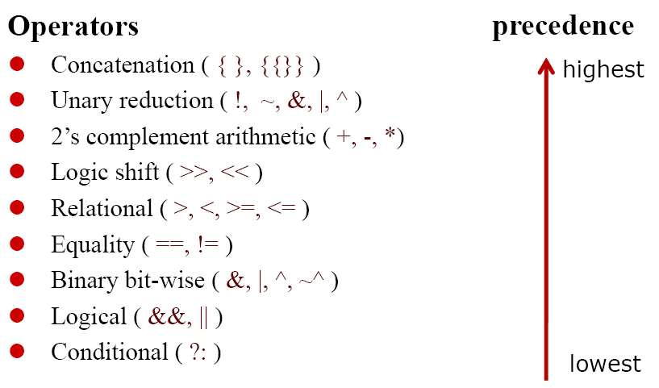
Synthesizable Operators

Slide 4
Synthesizable Verilog
Synthesizable constructs
“if - then - else” statement
“case” statement
“for” Loop statement
“function” statement
“always” statement
Primitive gates
Assign statement

Slide 5
NonSynthesizable Verilog constructs
Definition & Declaration
“User defined Primitive”
“Time”
“Event”
Ranges & Arrays for Integers
Real real time
Statement
“Defparam”, “Initial”, “Repeat”
“Delay”, “Event”, “Wait”, “Fork”
“Deassign”, “Force”, “Release”
Operation
“===“ & “!==“
Division & Modulus

Slide 6
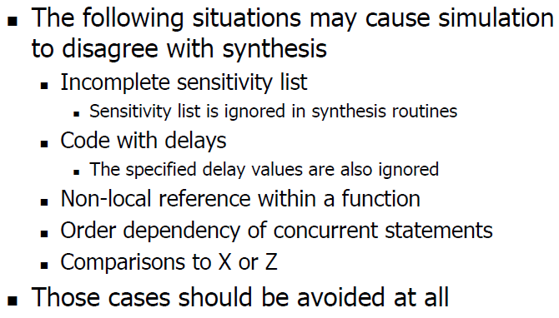
Inconsistent Results

Slide 7
Inferring Combinational Logic
Combinational logic can be inferred from Verilog codes in several ways.
Based on the type of variable declaration (reg or wire), always block and assign statements can be used to infer COMBO.
Care should be taken in the choice of the Verilog constructs used to infer COMBO.
Notes:
Latch Inference
Here, data_out is modified if signal enable is high. However, the model does not specify
what happens when enable is low (or unknown). The default behavior implied by Verilog
HDL is that the variable data_out will retain its previous value. This infers a storage element to implement the variable data_out. Since there is no clock edge
(either a rising or a falling edge) involved here, a latch is inferred when data input is data_in,

Slide 8
Inferring a Multiplexer using if-else statement
reg d_out ;
always @ (a or b or en)
if (en)
d_out = a ;
else
d_out = b;
The if ... else construct is completely specified.
The modeled logic is a combinational multiplexer.
a
M
U
X
d_out
b
en
a
b
en

Slide 9
Priority encoded Multiplexer using if-else if statement
Depending on the choice of “select” inputs, if - else if can be effectively used to model priority encoded “cascading” multiplexers.
en[2] en[1] en[0]
0 0 0
0 0 1
0 1 0
0 1 1
1 0 0
1 0 1
1 1 0
1 1 1
always @(a or b or c or d or en)
if (en[2] == 1’b1)
out = a;
else if (en[1] == 1’b1)
out = b;
else if (en[0] == 1’b1)
out = c;
else
out = d;

Slide 10
Priority encoded Multiplexer using if-else if statement
Priority encoded “cascading” multiplexers.
d
0
c
1
en[0]
0
b
1
en[1]
0
out
a
1
en[2]

Slide 11
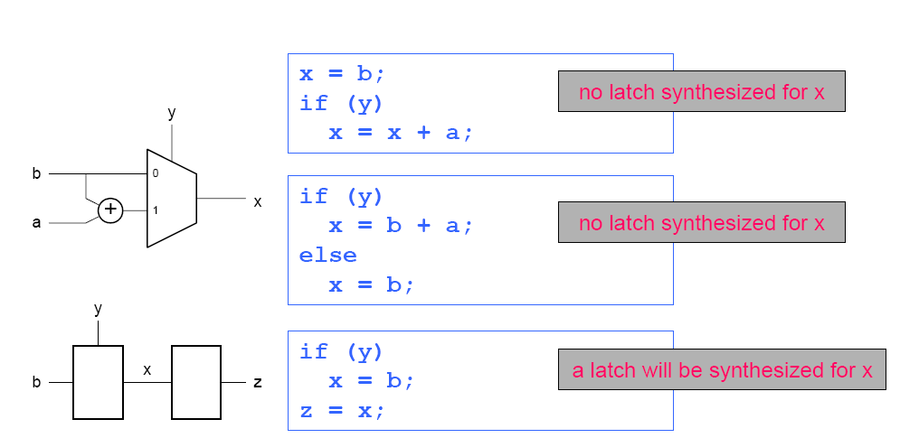
If -else

Slide 12
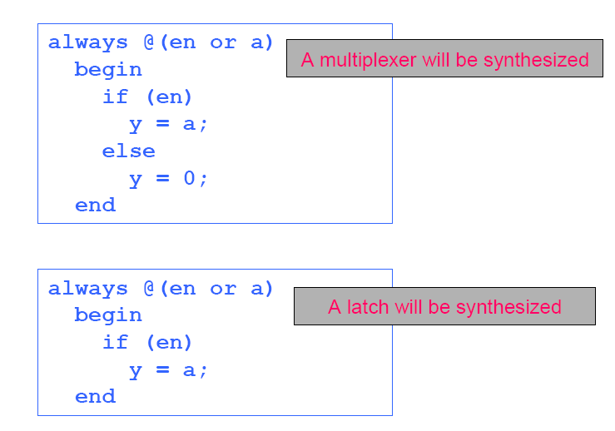
If-else

Slide 13
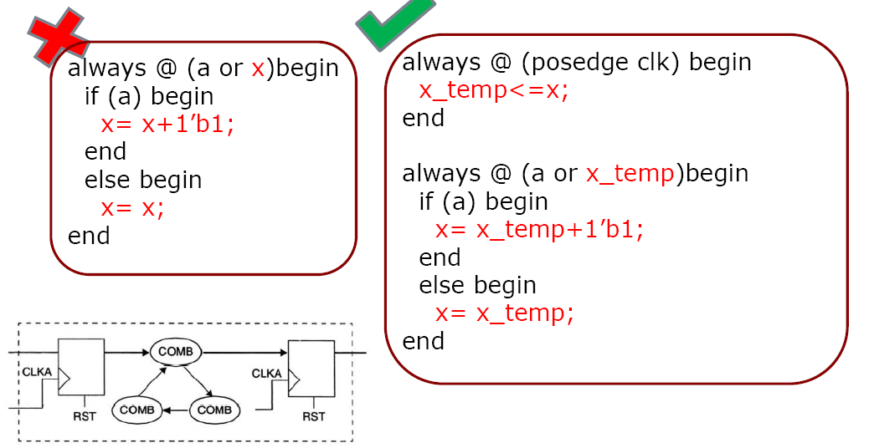
Avoid Combinational Feedback

Slide 14
Synthesis of Case statements
Case statements can synthesize to combinational or sequential logic.
This depends upon whether the case alternatives are completely specified or not.
A completely specified case construct can infer purely combinational multiplexers with its select lines activated on a priority basis.
Incomplete case specification infer latches.
Notes:
Latch Inference
Here, data_out is modified if signal enable is high. However, the model does not specify
what happens when enable is low (or unknown). The default behavior implied by Verilog
HDL is that the variable data_out will retain its previous value. This infers a storage element to implement the variable data_out. Since there is no clock edge
(either a rising or a falling edge) involved here, a latch is inferred when data input is data_in,

Slide 15
Inferring a Multiplexer using Case statement
Case statements infer faster and “large” (occupy more silicon area) multiplexers.
always @(a or b or c or d or en)
begin
case (en)
2’b00 : d_out = a;
2’b01 : d_out = b;
2’b10 : d_out = c;
default : d_out = d;
endcase
end
a
b
M
U
X
c
d_out
d
2
en

Slide 16
Incomplete case statements infer latches
When a case statement specifies only a partial list of alternatives, a latch is inferred.
always @(a or b or c or en)
begin
case (en)
2’b00 : d_out = a;
2’b01 : d_out = b;
2’b10 : d_out = c;
endcase
end
In this sample code, the case alternative for en = 11 is not specified.
This makes the synthesis tool to infer a latch to store the previous value of d_out when en = 11 is encountered.

Slide 17
Avoiding inference of latches in Case statements
Latch inference can be avoided by either an unconditional assignment or using default statements.
always @(a or b or c or en)
begin
d_out = a;
case (en)
2’b00 : d_out = a;
2’b01 : d_out = b;
2’b10 : d_out = c;
endcase
end
always @(a or b or c or en)
begin
case (en)
2’b00 : d_out = a;
2’b01 : d_out = b;
2’b10 : d_out = c;
default : d_out = a;
endcase
end

Slide 18
Tips to avoid unintentional latches in Case & if-else if statements
For both Case and if-else if statements, it is necessary to specify all clauses (alternatives).
It is also necessary to specify all outputs for every alternative in Case and if - else if statements.
Notes:
Latch Inference
Here, data_out is modified if signal enable is high. However, the model does not specify
what happens when enable is low (or unknown). The default behavior implied by Verilog
HDL is that the variable data_out will retain its previous value. This infers a storage element to implement the variable data_out. Since there is no clock edge
(either a rising or a falling edge) involved here, a latch is inferred when data input is data_in,

Slide 19
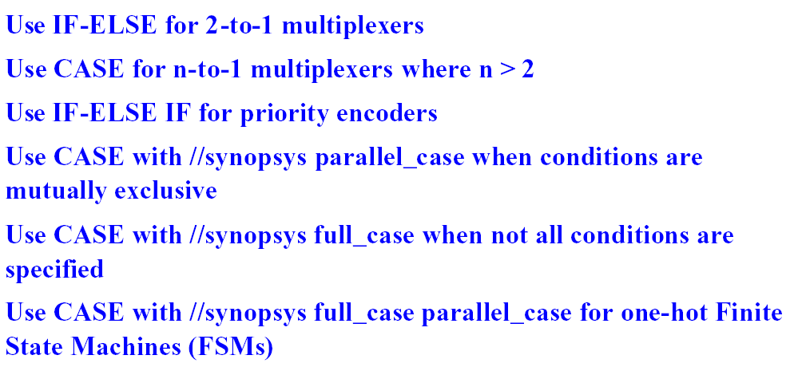
If-else VS case

Slide 20
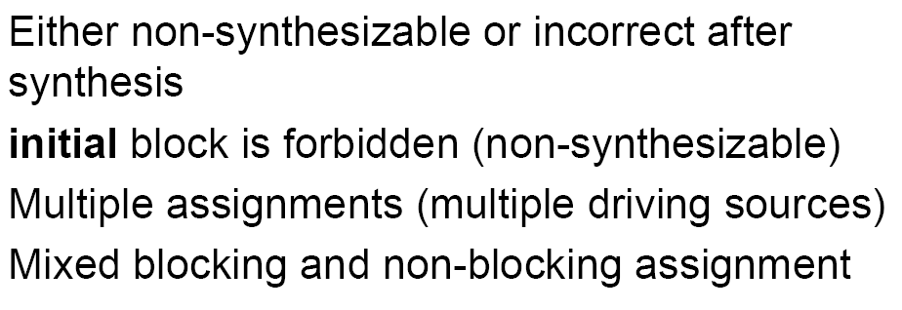
Synthesizable coding style

Slide 21
Synthesis of For loops
For loops can be used to infer cascaded combinational logic blocks.
For loops cannot contain any timing or event control constructs.
integer k;
always @ (x or y)
begin
for ( k = 0; k < 5; k = k + 1)
sample[k] = x[k] | y[4 - k];
end
will be synthesized as a series of sequential assignments as follows:
sample[0] <= x[0] or y[4];
sample[1] <= x[1] or y[3];
sample[2] <= x[2] or y[2];
sample[3] <= x[3] or y[1];
sample[4] <= x[4] or y[0];

Slide 22
Equivalent gate level representation
sample[0]
x[0]
y[4]
x[1]
y[3]
sample[1]
x[2]
y[2]
sample[2]
x[3]
y[1]
sample[3]
x[4]
y[0]
sample[4]

Slide 23
Synthesis of For loops
integer k;
for ( k = 0; k <= 7; k = k + 1)
{ c_temp, sum[k] } = a_in[k] + b_in[k] + c_in;
c_out = c_in;
end
The above piece of for loop code would typically synthesize to an 8-bit ripple carry adder.

Slide 24
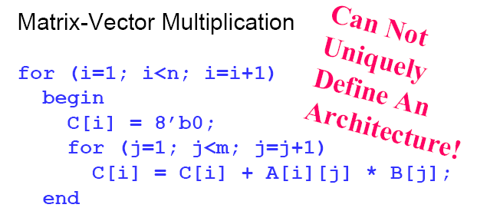
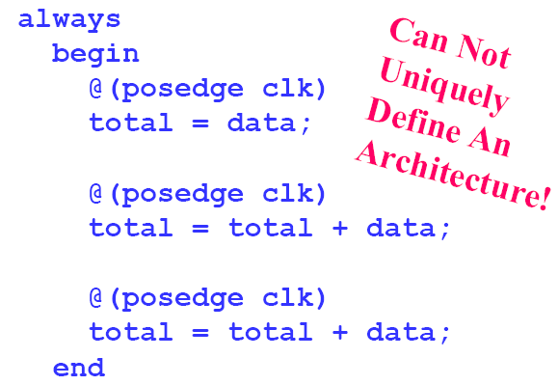
Non Synthesizable code

Slide 25
The assign statement
The assign statement in Verilog can be used to synthesize combinational logic.
assign d_out = (a | b) & c; translates to:
a
b
c
d_out
If a, b, c and d_out are multi-bit vectors, say 3-bit vectors, then, three identical circuits as above would be generated.

Slide 26
The ternary ? operator
The ternary conditional operator ? typically infers a combinational multiplexer circuit.
assign d_out = (en ? b : a);
a
d_out
b
en

Slide 27
Instantiation of MUX Vs. Case & if-else
Instantiating a multiplexer is preferred than using an if - else or case statement when structured implementation with faster synthesis results are needed.
But instantiation makes it technology dependent and elaborate RTL description.
if-else and Case statements create technology independent and concise representations.
Notes:
Latch Inference
Here, data_out is modified if signal enable is high. However, the model does not specify
what happens when enable is low (or unknown). The default behavior implied by Verilog
HDL is that the variable data_out will retain its previous value. This infers a storage element to implement the variable data_out. Since there is no clock edge
(either a rising or a falling edge) involved here, a latch is inferred when data input is data_in,

Slide 28
Use of arithmetic operators Vs. Design blocks
Arithmetic operators lead to large gate level logic, but result in concise representation of code in a technology independent manner.
Designing custom blocks for arithmetic functions can take longer duration, but makes it more technology dependent.
Notes:
Suppose you want to add two 8 bit vectors, and there is an 8 bit adder macro available in your target technology. You could use the “+” operator to add these two vectors.
The alternative is to define a component that has the same name and inputs and outputs as the hard macro you want to use. Instantiate the component in your Verilog description and connect the inputs and output to the their appropriate signals.
The synthesis tools instantiate the hard macro without having to bother with the complicated optimization of the internal logic implemented by the macro.
This speeds up the optimization process considerably.

Slide 29
Synthesis of function statement
Functions are synthesized to combinational logic blocks.
They can have only one output variable.
The output can be a scalar or a vector.
Notes:
Latch Inference
Here, data_out is modified if signal enable is high. However, the model does not specify
what happens when enable is low (or unknown). The default behavior implied by Verilog
HDL is that the variable data_out will retain its previous value. This infers a storage element to implement the variable data_out. Since there is no clock edge
(either a rising or a falling edge) involved here, a latch is inferred when data input is data_in,

Slide 30
Use of Parentheses
Parentheses plays vital role in the type of logic implemented.
F = a + b + c + d;
would typically be implemented as:
(a + b) is grouped together by default,
then c and d are added one at a time.
a
b
c
d
z

Slide 31
Use of Parentheses
F = (a + b) + (c + d);
would typically be implemented as:
Parentheses use leads to a faster implementation of the addition.
a
b
c
d
z

Slide 32
Order dependency Non blocking Vs. blocking
Blocking statements are executed in the order which they have been represented.
Non-blocking assignments are executed independent of the order of specification
always @(negedge CK)
begin
a <= x | y;
b <= a;
c <= b;
end
x
D Q
c
y
D Q
D Q
CK

Slide 33
Order dependency Non blocking Vs. blocking
In the sample code shown, the order of the non-blocking assignments have been changed.
But an identical logic will be generated by the synthesis tool.
always @(negedge CK)
begin
c <= b;
b <= a;
a <= x | y;
end
x
D Q
c
y
D Q
D Q
CK

Slide 34
Order dependency Non blocking Vs. blocking
Blocking assignment example
always @(negedge CK)
begin
a = x | y;
b = a;
c = b;
end
x
c
y
D Q
CK

Slide 35
Order dependency Non blocking Vs. blocking
A blocking assignment with order changed
always @(negedge CK)
begin
c = b;
b = a;
a = x | y;
end
x
D Q
c
y
D Q
D Q
CK

Slide 36
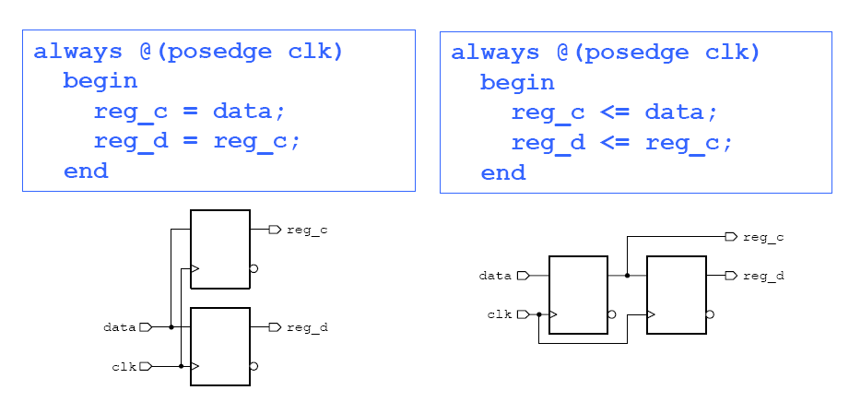
Non blocking Vs. blocking

Slide 37
Non blocking Vs. blocking assignments with multiple drivers
Multiple blocking assignments are evaluated as they occur.
Multiple non-blocking assignments are scheduled, hence only the last assignment is synthesized.
Synthesis tools generally do not support both blocking and non-blocking assignments to the same signal.

Slide 38
Use of Non blocking & blocking assignments
It is recommended to use non-blocking assignments exclusively within sequential always blocks.
In combinational logic blocks, it is recommended to use as much blocking assignments as possible.

Slide 39
Inferring a level sensitive latch
reg d_out ;
always @ (d_in or en)
begin
if (en == 1’b1)
d_out = d_in ;
end
d_in
Latch
d_out
en
When “en” is not true, the previous value of d_out is stored.
Since there is no specification of a clock edge using posedge or negedge, a latch is inferred.

Slide 40
How to avoid a Latch inference ?
always @ (d_in or en)
begin
if (en)
d_out = d_in;
else
d_out = 0;
end
When “en” is not true, the d_out is assigned to 0, i.e...
d_out is assigned a value under all conditions, avoiding a latch inference.
d_in
COMBO
d_out
en

Slide 41
Inferring a Level sensitive Latch with Set and Reset
reg data_out ;
always @(d_in or en or set or reset)
if (set)
d_out = 1’b1 ;
else if (reset)
d_out = 1’b0 ;
else if (en)
d_out = d_in;
d_out is assigned to data_in only when set and reset are inactive and en is active.
reset
set
d_in
d_out
Latch
en

Slide 42
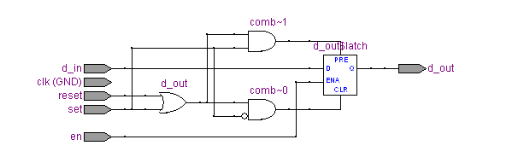
Inferring a Level sensitive Latch with Set and Reset

Slide 43
Edge sensitive D-Flip flop
reg d_out ;
always @ (posedge clk)
d_out = d_in;
An edge triggered flip-flop is inferred if a variable assignment is executed only on the leading or trailing edge of another variable.
posedge and negedge are Verilog keywords used to represent leading and trailing edges respectively.
d_in
Edge sensitive
Flip-flop
d_out
clk
en

Slide 44
Edge sensitive D-Flip flop with Synchronous Set and Reset
reset
set
reg d_out ;
always @(posedge clk)
if (set)
d_out = 1’b1 ;
else if (reset)
d_out = 1’b0 ;
else
d_out = d_in;
Conditional assignments to d_out is done inside the if clause and they translate into combinational logic in front of the D-input of the flip-flop.
The sensitivity list should contain only clk variable.
Edge sensitive
Flip-flop
d_in
d_out
clk

Slide 45
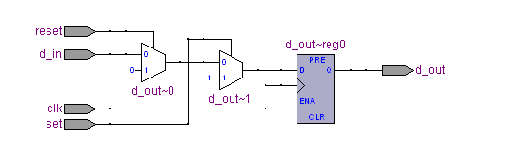
Edge sensitive D-Flip flop with Synchronous Set and Reset - Hardware

Slide 46
Edge sensitive D-Flip flop with Asynchronous Set and Reset
reset
set
reg d_out ;
always @(posedge clk or
posedge set or posedge reset)
if (set)
d_out = 1’b1 ;
else if (reset)
d_out = 1’b0 ;
else
d_out = data_in;
Edge sensitive
Flip-flop
d_in
d_out
clk
en

Slide 47
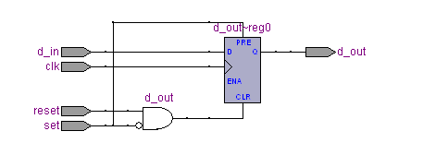
Edge sensitive D-Flip flop with Asynchronous Set and Reset -Hardware

Slide 48
Edge sensitive D-Flip flop with Asynchronous Set and Reset
For asynchronous set and reset, both the set and reset variables must be in the sensitivity list.
Asynchronous assignments can be done using else if clauses and they should occur first based on priority.
Synchronous assignments should come last one in the if clause.
A flip-flop is generated for each signal that is assigned in the synchronous assignment.
The asynchronous clauses result in combinational logic that drives the set and reset inputs of the flip-flops.
Notes:
Latch Inference
Here, data_out is modified if signal enable is high. However, the model does not specify
what happens when enable is low (or unknown). The default behavior implied by Verilog
HDL is that the variable data_out will retain its previous value. This infers a storage element to implement the variable data_out. Since there is no clock edge
(either a rising or a falling edge) involved here, a latch is inferred when data input is data_in,

Slide 49
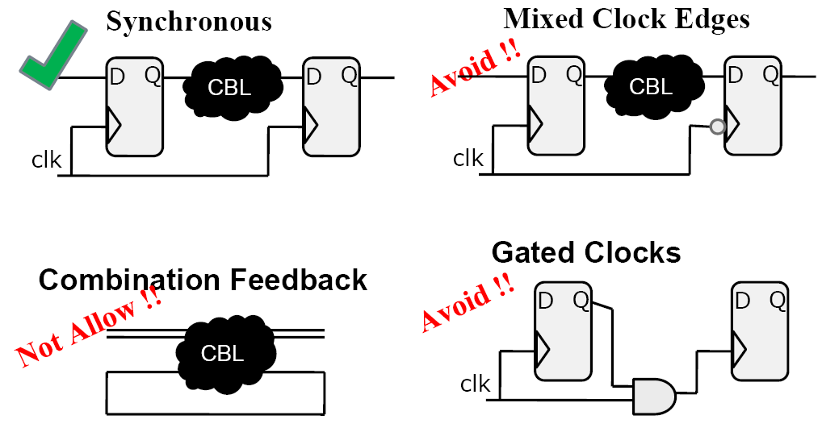
Concept of Clocks and Reset

Slide 50
General limitations of D-Flip flop inference
The signal in an edge expression of the always block cannot be an indexed.
always @ (negedge clk[1]) ---> clk is indexed.
Set - Reset conditions must be constructed only using single bit variables.
Set and reset conditions cannot use complex expressions.
Notes:
Latch Inference
Here, data_out is modified if signal enable is high. However, the model does not specify
what happens when enable is low (or unknown). The default behavior implied by Verilog
HDL is that the variable data_out will retain its previous value. This infers a storage element to implement the variable data_out. Since there is no clock edge
(either a rising or a falling edge) involved here, a latch is inferred when data input is data_in,

Slide 51
How to get good results in Flip-flop inferences ?
A flip-flop is generated for each signal that is assigned in the synchronous assignment.
i.e.. an always block that contains a clock edge in the sensitivity list infers a flip-flop for each variable assignment that block.
It is necessary to make sure the HDL description builds only as many flip-flops as the design requires.
Notes:
Latch Inference
Here, data_out is modified if signal enable is high. However, the model does not specify
what happens when enable is low (or unknown). The default behavior implied by Verilog
HDL is that the variable data_out will retain its previous value. This infers a storage element to implement the variable data_out. Since there is no clock edge
(either a rising or a falling edge) involved here, a latch is inferred when data input is data_in,

Slide 52
How to get good results in Flip-flop inferences ?
module count (CLK, RST, AND_L, OR_L, XOR_L);
input CLK, RST;
output AND_L, OR_L, XOR_L;
reg AND_L, OR_L, XOR_L;
reg [2:0] CNT;
always @(posedge CLK) begin
if (RST)
CNT = 0;
else
begin
CNT = CNT + 1;
AND_L = & CNT; Need not be
OR_L = | CNT; registered, can be
XOR_L = ^ CNT; put in a separate
end COMBO block.
endmodule
In this example, the always block includes assignments to calculate the reduction AND, OR and XOR logic.
The reduction AND, OR and XOR outputs solely depend on the registered output CNT.
Hence it is not necessary to register the logic outputs again, instead an asynch. always block with CNT variable is sufficient.

Slide 53
Synthesis directives
Synthesis directives are special comments which the synthesis tools interpret and perform certain actions.
Comments which specify such directives cannot contain extra characters other that the required for the directive.

Slide 54
Example Synthesis directives
Code selection directive in Cadence Ambit synthesis tool.
// ambit synthesis off -- All the code following up to and including the following directive // ambit synthesis on will not be considered for synthesis.
Particularly useful with typical initialization and debugging features of the HDL code.

Slide 55
Example Synthesis directives
// ambit synthesis off
initial
begin
check_flag = 0 ;
$display(“check_flag cleared ”) ;
end
// ambit synthesis on
always @(negedge clk)
if (check_flag == 1’b0)
...

Slide 56
Example Synthesis directives
Case Statement Directives in
Cadence Ambit Synthesizer
The default interpretation of a case statement is priority encoding of the case labels in the order the alternatives are listed.
This is similar to interpretation of a nested if-else statement.

Slide 57
Example Synthesis directives
The directive is used as follows:
// ambit synthesis case = value
where value = full, parallel
The directive must appear immediately after the case expression.
A full case directive is specified as follows:
always @(negedge clk)
case (sel) // ambit synthesis case = full
...
endcase

Slide 58
Full case directive
A full case directive
implies that all possible values not covered by case expression can be treated as don’t care conditions.
This further means that there is no need for a default clause in the case statement and no latch should be inferred.
To avoid latch inference, all possible outputs in the case alternatives must be specified.

Slide 59
Full case directive
input [1:0] x;
always @(x or a or b or c or d)
begin
case (x)
2’b00: y = a ;
2’b01: y = b ;
2’b10: y = b ;
2’b11: y = d ;
endcase
end
The case statement shown is a full case because, all possible alternatives of the variable x is listed and the output is assigned a value in each alternative.
A latch will not be inferred for the output y.
The case construct will be synthesized to a multiplexer whose select inputs are decoded through a priority logic.

Slide 60
Full case directive
input [1:0] x;
always @(x or a or b or c or d)
begin
case (x) /* ambit synthesis case = full */
2’b00: y = a ;
2’b01: y = b ;
2’b10: y = b ;
endcase
end
In this example, the fourth alternative for x is missing, but the full case directive will direct the synthesizer not to infer a latch for y.
Again the case construct will be synthesized to a multiplexer whose select inputs are decoded through a priority logic.

Slide 61
Parallel case directive
always @(a or b)
begin
case (2’b00) /* ambit case = parallel */
a: y = 10 ;
b: y = 01 ;
endcase
end
If the case statement contains a parallel case directive then it means that all the case alternatives have equal priority of matching the case expression.
The optimizer builds a parallel decoding logic instead of a priority encoder logic to drive the select lines for the multiplexer.
This case statement is not a full case either.

Slide 62
Parallel case directive
always @(a or b)
begin
case (2’b00) /* ambit case = parallel */
a: y = 10 ;
b: y = 01 ;
endcase
end
If the case expression matches more than one case label, the logic corresponding to each case label will be enabled. This may produce unexpected results.
The designer should ensure that such an overlap does not occur before using the parallel case directive.
This case statement is not a full case either.

Slide 63
Synopsys case directives
reg [1:0] d_in, d_out;
reg [3:0] cur_state, next_state;
parameter
s1 = 4’b0001, s2 = 4’b0010, s3 = 4’b0100, s4 = 4’b1000;
case (d_in) /* synopsys full_case */
0: out = 2;
1: out = 3;
2: out = 0;
endcase
case (1) /* synopsys parallel_case full_case */
cur_state[0] : next_state = s2;
cur_state[1] : next_state = s3;
cur_state[2] : next_state = s4;
cur_state[3] : next_state = s1;
endcase
Both full_case and parallel_case included.

Slide 64
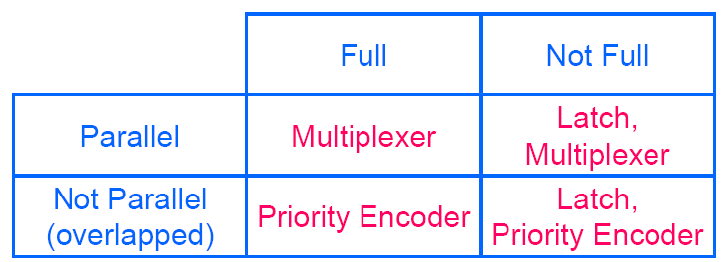
Synopsys case directives

Slide 65
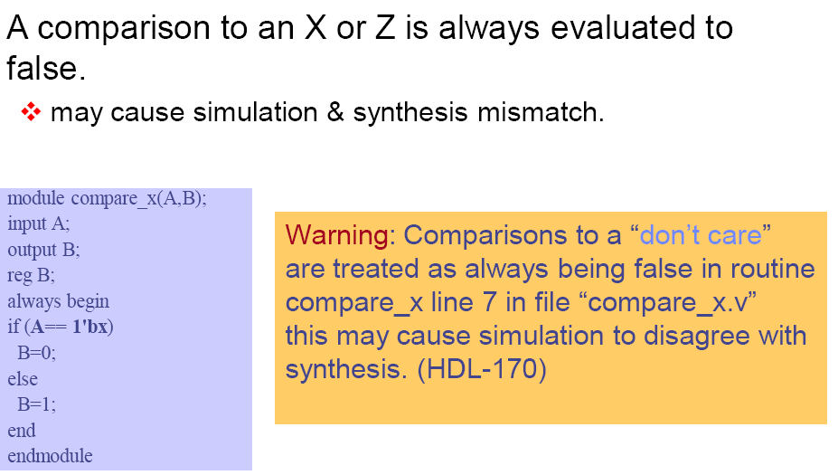
Comparisons to X or Z

Slide 66
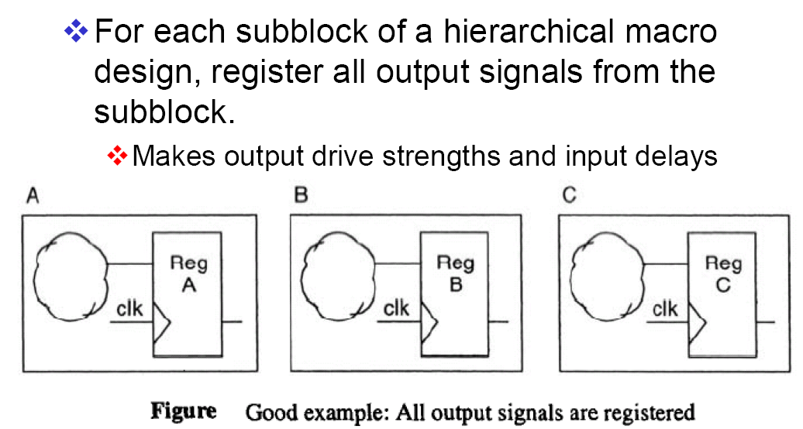
Register All Outputs

Slide 67
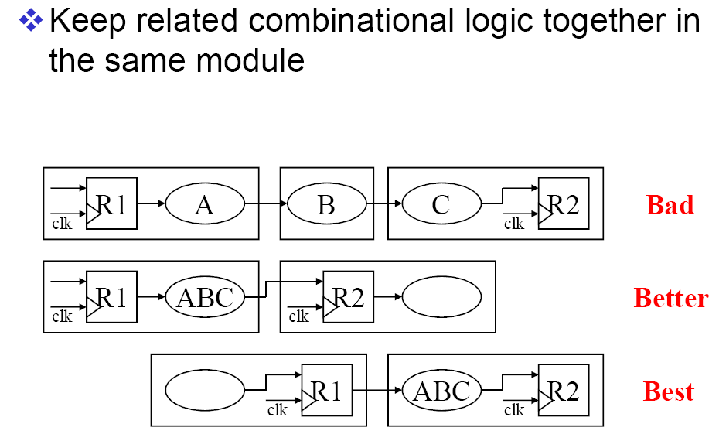
Locate Related Combinational Logic in a Single Module

Slide 68
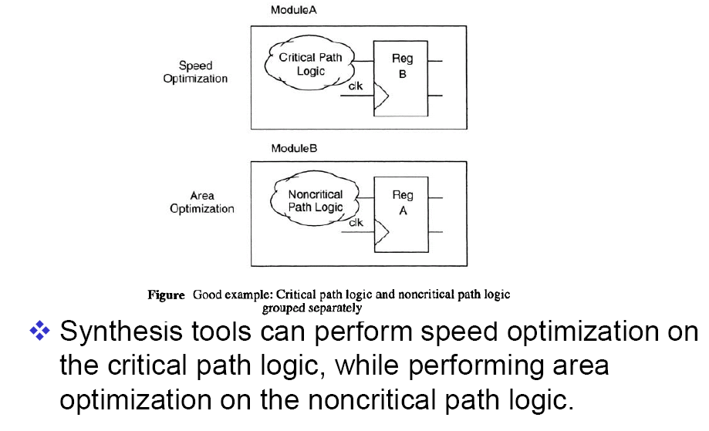
Separate Modules that Have Different Design Goals

Slide 69
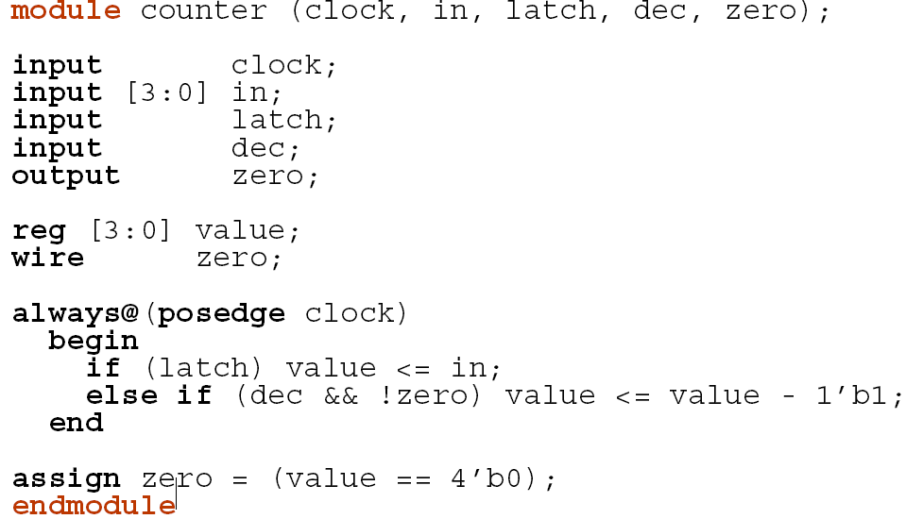

Slide 70
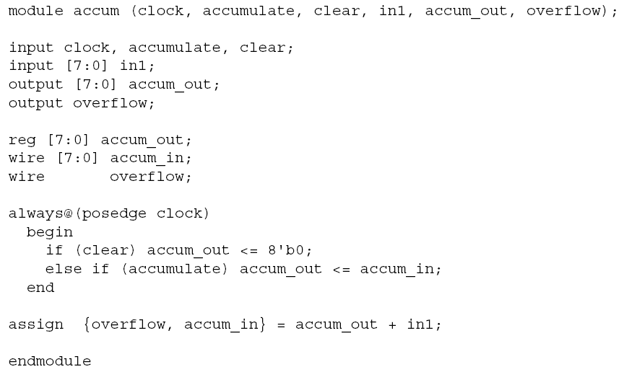

Slide 71
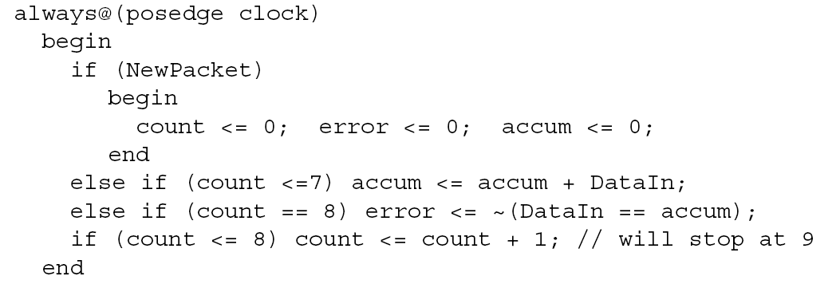

Slide 72
Reference
Samir Palnitkar,”Verilog HDL: A Guide to Digital Design and Synthesis” Prentice Hall, Second Edition,2003
T.R.Padmanabhan and B.Bala Tripura Sundari, “Design Through Verilog HDL” Wiley Student Edition
J.Bhaskar, “ Verilog HDL Synthesis” BS publications

